Slide 1
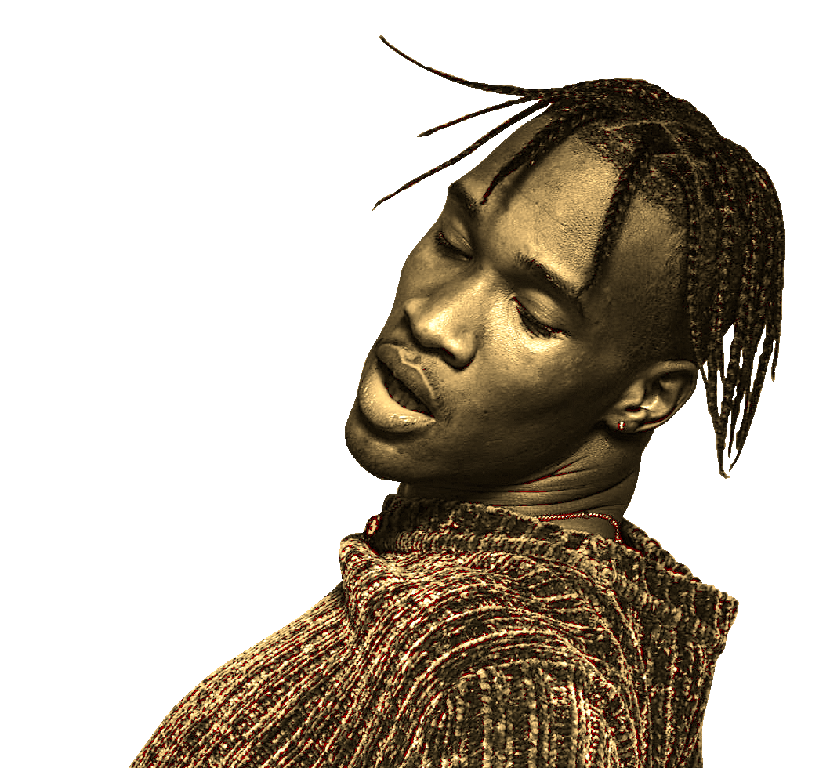

Spotify
By Joshua Au-Yeung & Haichen Zhang
Top songs Analysis

Slide 2

Objectives
Study the correlation between musical attributes and song popularity
Build machine learning model to predict song popularity based on Musical Attributes

Slide 3
Overview
What makes a song successful? Why do some songs get popular. Using data, we can find a quantitative answer to whether musical attributes have an impact on song popularity
Notes:
Objective: What are you setting out to prove or predict?
What is your rationale for there being a correlation in the data that you’re looking to confirm and/or exploit?

Slide 4
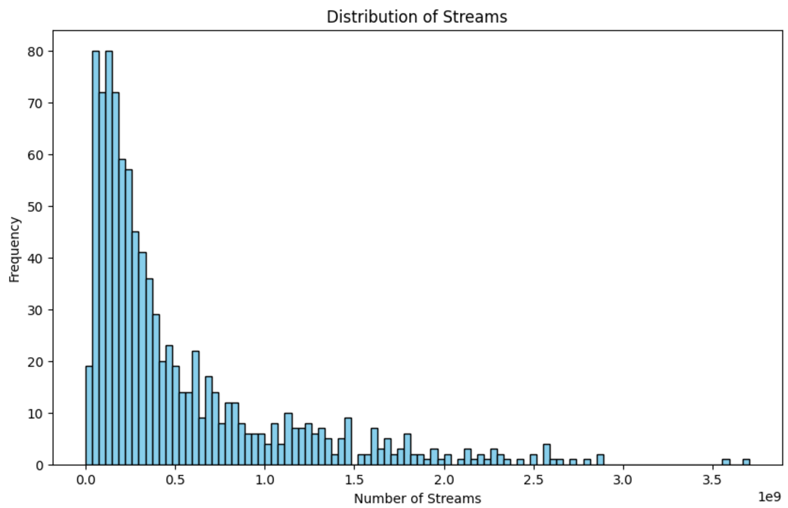
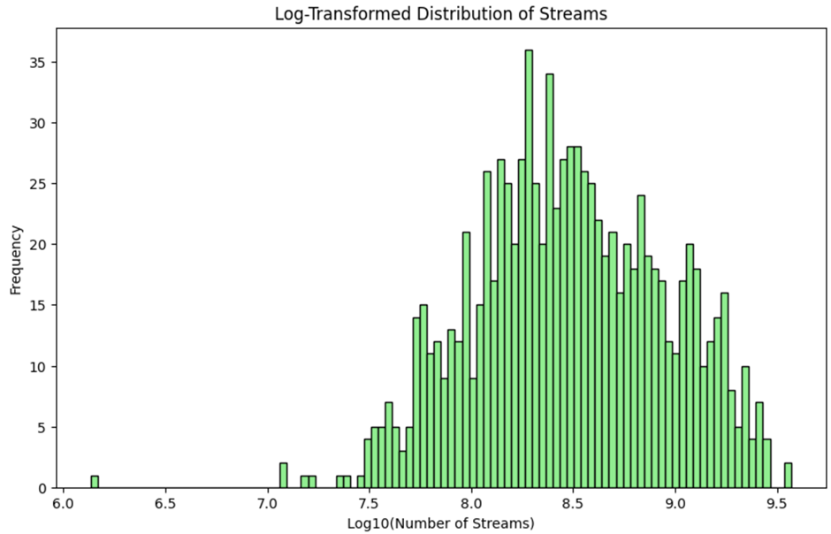

Streaming
The raw streams data exhibited a high variance with a right-skewed distribution.
Log-transformation makes it easier to see where the majority of the song’s streaming numbers lie, with few songs that take the top spot in streaming. But the data is still not normally distributed due to outliers and heavy tails.

Slide 5
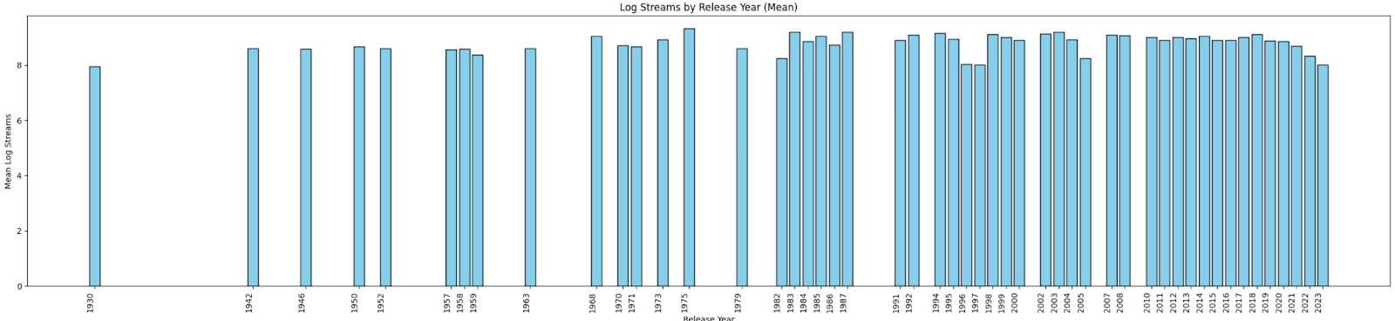
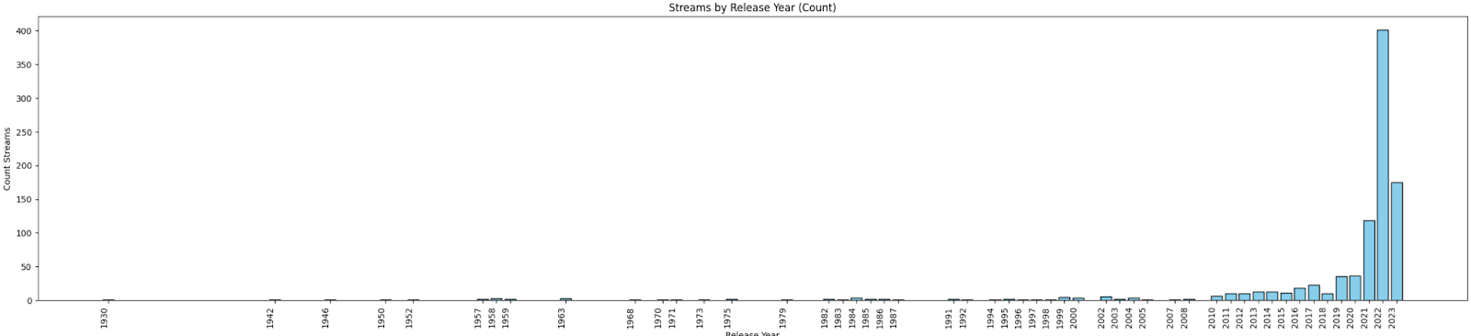
The dataset contains only highly streamed songs with a mean stream number over ~500MM.
The dataset heavily focuses on post-2011 songs, especially 2022 releases, limiting insights for musical trends over the earlier years.

Slide 6
Dataset Statistics
Statistic | artist_count | released_month | released_day | bpm | danceability_% | valence_% | energy_% | acousticness_% | instrumentalness_% | liveness_% | speechiness_%
count | 953 | 953 | 953 | 953 | 953 | 953 | 953 | 953 | 953 | 953 | 953
mean | 1.56 | 6.03 | 13.93 | 122.5 | 66.97 | 51.43 | 64.28 | 27.06 | 1.58 | 18.21 | 10.13
std | 0.89 | 3.57 | 9.2 | 28.06 | 14.63 | 23.48 | 16.55 | 26 | 8.41 | 13.71 | 9.91
min | 1 | 1 | 1 | 65 | 23 | 4 | 9 | 0 | 0 | 3 | 2
25% | 1 | 3 | 6 | 100 | 57 | 32 | 53 | 6 | 0 | 10 | 4
50% (Median) | 1 | 6 | 13 | 121 | 69 | 51 | 66 | 18 | 0 | 12 | 6
75% | 2 | 9 | 22 | 140 | 78 | 70 | 77 | 43 | 0 | 24 | 11
max | 8 | 12 | 31 | 206 | 96 | 97 | 97 | 91 | 97 | 97 | 64
Notes:
Data Preparation: What was your data source (e.g. web scraping, corporate data, a standard machine learning data set, open data, etc.)?
How good was the data quality?
What did you need to do to procure it?
What tools or code did you need to use to prepare it for analysis? What challenges did you face?

Slide 7
key | A | A 2 | A# | A# 3 | B | B 4 | C# | C# 5 | D | D 6 | D#
mode | Major | Minor | Major | Minor | Major | Minor | Major | Minor | Major | Minor | Major
count | 42 | 33 | 27 | 30 | 35 | 46 | 73 | 47 | 66 | 15 | 12
key | D# | E | E | F | F | F# | F# | G | G | G# | G#
mode | Minor | Major | Minor | Major | Minor | Major | Minor | Major | Minor | Major | Minor
count | 21 | 17 | 45 | 44 | 45 | 30 | 43 | 66 | 30 | 63 | 28
Keys and Modes
(No key of C!)

Slide 8
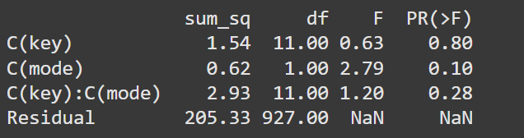
Two Way anova Test
Null hypothesis: there is no difference in interaction effect between key and mode on streams.
Alternative hypothesis: there is significant interaction effect between key and mode on streams.
Surprising results. The key has a high p-value: 0.8. The key has no significant effect on streams.
The mode has a p-value of 0.10: a slight influence on streams, but not at significance levels.
The interaction of key and mode has a p-value of 0.28, which indicate that the combination of key and mode has no significant influence on streams.

Slide 9
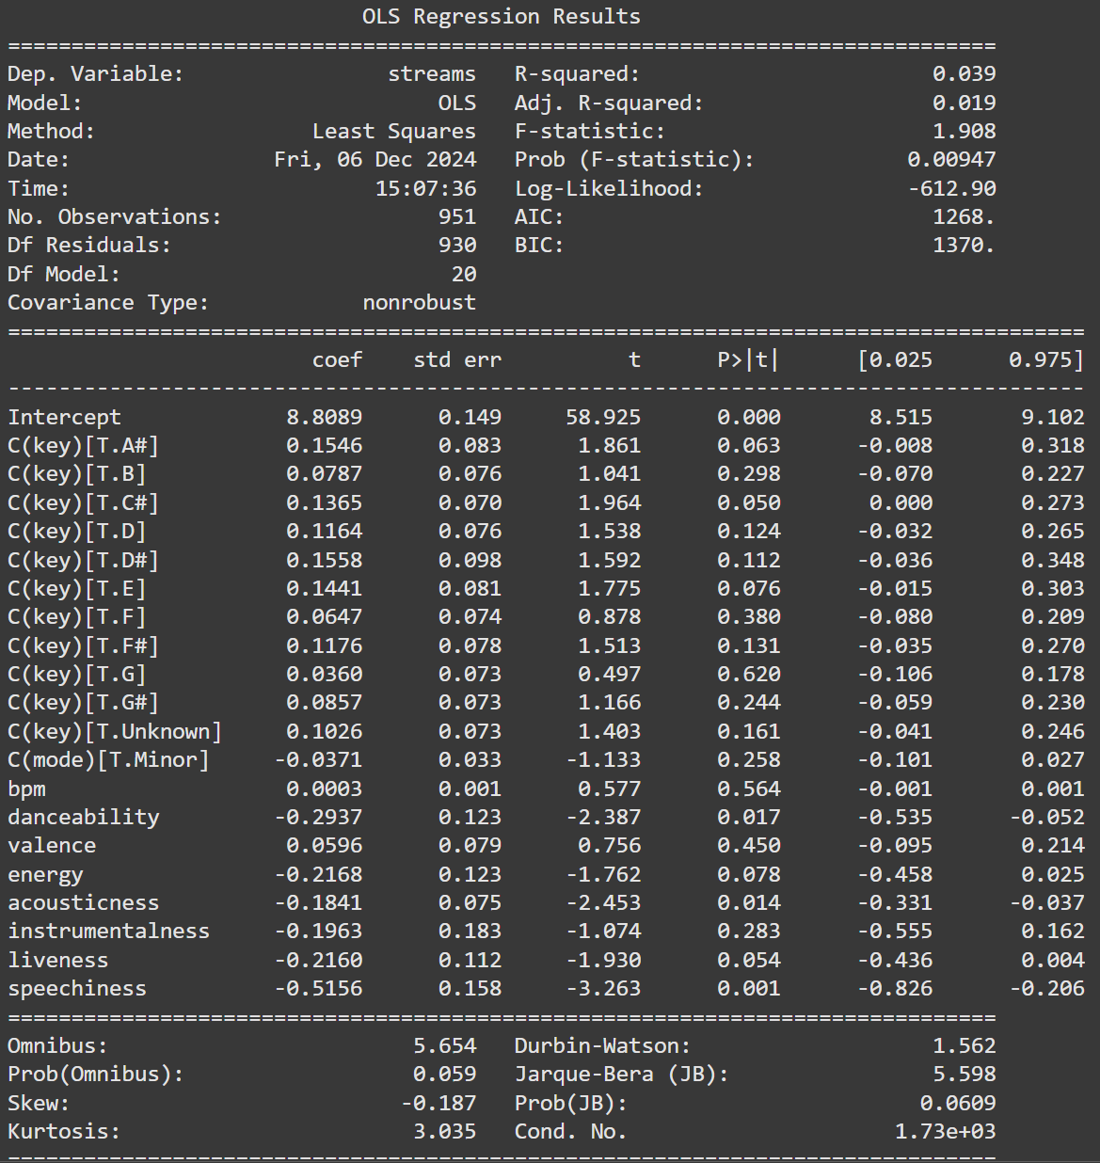
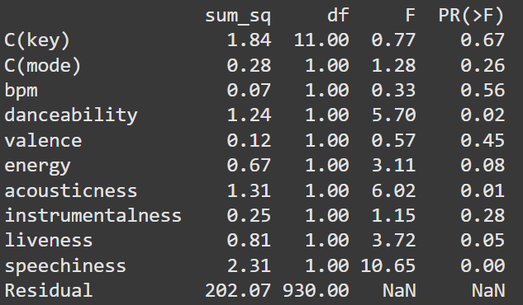
OLS (all musical attributes)
Null hypothesis:
None of the musical attributes (danceability, speechiness, liveness, etc.), the song key, or the mode have a significant effect on the log-transformed number of streams.
Alternative hypothesis:
At least one musical attribute, key, or mode has a significant effect on the log-transformed number of streams.

Slide 10
Test Interpretation
R-squared = 0.039: This means that only 3.9% of the variance in log-transformed streams is explained by the included musical attributes, suggesting an overall weak relationship. Adjusted R-squared = 0.019, reinforcing the weak predictive power of the model. Most of the variability in streaming numbers are unexplained, this is likely driven by non-musical factors (e.g., artist popularity, playlist inclusion, or marketing).
The F-statistic of 1.908 is low and indicates that the model has weak explanatory power. It doesn't do a good job of predicting the song streams. The Prob (F-statistic) is low enough to be significant. So even though the model of the whole doesn't predict well, there is evidence that at least one of the musical attributes is related to the song streams.

Slide 11
OLS Regression Interpretation
Danceability’s coefficient is -0.2937, indicating a negative relationship between danceability and streams. For a 1-unit increase in danceability, the log-streams decrease by approximately 0.2937 units. This is very surprising, I would have expected the opposite to be true in that the more danceable, the more streams.
Speechiness coefficient is -0.5156, indicating a negative relationship. Songs with higher speechiness tend to have lower log-streams. Acousticness coefficient is -0.1841, suggesting a negative relationship. Songs with higher acoustic qualities are less likely to have high log-streams.
Other musical attributes have high p-values above statistically significant levels, so we won't discuss those. They are showing no effect on song streams.
We reject the null hypothesis some of these attributes have significantly influence on streams.
Notes:
Conclusions: Did you prove/disprove your hypothesis or create a useful model? What did you learn about your data set?

Slide 12
Optimal musical attributes for song
Machine Learning model
RandomForestRegressor is a machine learning algorithm used for regression tasks. It is part of the ensemble methods family and is implemented in libraries such as scikit-learn.
Random forests operate by building multiple decision trees during training and combining their outputs to make predictions.
Notes:
RandomForestRegressor is a powerful, flexible algorithm that works well for many regression tasks. Its ability to handle non-linear relationships, robustness to overfitting, and feature importance analysis make it a popular choice among data scientists and machine learning practitioners, so this should be a good choice for our data.

Slide 13



Random Forest Regressor
Ensemble of Decision Trees
A Random Forest is essentially a collection (ensemble) of decision trees.
Each tree is trained on a random subset of the data (with replacement: bootstrapping).
Averaging Predictions
Why we chose it. How It works
For regression tasks, predictions from each decision tree are averaged to provide the final output. This reduces variance and improves robustness.
Feature Randomness
During training, each tree is allowed to consider only a random subset of features when splitting nodes. This prevents overfitting and ensures diversity among the trees.

Slide 14
Model Improvements
Define the Hyperparameters to Tune
Specify a set of hyperparameters and their possible values.
Create a Grid of Hyperparameters
Hyperparameter Tuning with Grid Search
Grid Search will test every possible combination of the hyperparameters within the specified ranges.
Evaluate Each Combination
For each combination, the model is trained and validated using cross-validation to ensure robustness.
Choose combination with best score on validation set
Notes:
Grid Search is a systematic method to perform hyperparameter tuning. It exhaustively searches through a specified subset of hyperparameter combinations to find the best-performing set based on a scoring metric like accuracy, mean squared error, or R-squared.

Slide 15
Random Forest Regressor Results
Fitting 3 folds for each of 20 candidates, totalling 60 fits
Best parameters found: {'n_estimators': 100, 'min_samples_split': 2, 'min_samples_leaf': 4, 'max_depth': 10, 'bootstrap': True}
Optimized Mean Squared Error: 2.5225785342976077e+17 (before tuning, was 2.7101427811146464e+17)
Optimized R-squared: -0.030495366955971992 (before turning was -0.10711700022669324)
After optimizing our model, we were able to reduce our Mean Squared Error slightly. But its still a huge number. So our model still isn't very predictive.
Our optimized R-squared value improved a little too, now its closer to 0. But an R-Squared value of 0 just means that the model predicts none of the variance. So it's still an ineffective model for predicting streams.
Notes:
Conclusions: Did you prove/disprove your hypothesis or create a useful model? What did you learn about your data set?
n_estimators: 100
This is the number of trees in the forest.
A value of 100 means the Random Forest model builds 100 decision trees and aggregates their predictions for the final output (either averaging for regression or voting for classification).
min_samples_split: 2
This is the minimum number of samples required to split an internal node.
A value of 2 means a node will be split if it has at least 2 samples. Lower values allow deeper trees, which may increase model complexity and the risk of overfitting.
min_samples_leaf: 4
This is the minimum number of samples that a leaf node must have.
A value of 4 ensures that no leaf has fewer than 4 samples. This helps prevent overfitting by restricting the growth of the trees.
max_depth: 10
This is the maximum depth of the trees.
A value of 10 means that no tree can have more than 10 levels. Restricting depth reduces model complexity, helping prevent overfitting while maintaining good performance.
bootstrap: True
This indicates whether bootstrap sampling is used when building trees.
A value of True means the model samples data with replacement when building each tree. Bootstrap sampling introduces randomness, which is a key part of why Random Forest models work well (reducing overfitting).

Slide 16
feature importance
Feature | Importance
released_day | 0.182018
bpm | 0.108816
danceability_% | 0.103542
released_month | 0.101770
acousticness_% | 0.098744
valence_% | 0.091530
liveness_% | 0.087118
energy_% | 0.071582
key | 0.060537
speechiness_% | 0.050265
artist_count | 0.021124
mode | 0.020221
instrumentalness_% | 0.002732
Importance values indicate the relative contribution of each feature. A higher value means the feature is more influential in making predictions. The sum of all importance scores equals 1 (or 100% if expressed as percentages).
released_day (0.182018) is the most important feature, meaning variations in the day a song is released have the greatest effect on the target variable (e.g., streams).

Slide 17
Model's optimal feature combination
Feature | Value
artist_count | 3.0
released_month | 7
released_day | 31
bpm | 168.89
key | 11
mode | 1
danceability_% | 0.1111
valence_% | 0.7778
energy_% | 0.6667
acousticness_% | 0
instrumentalness_% | 0.8889
liveness_% | 0.5556
speechiness_% | 0.3333
predicted_streams | 1,338,916,000
Three artists
Released in July on the 31st
A relatively fast tempo (around 169 bpm)
A key of B major or similar
A major scale mode
Moderate energy, positivity (valence), and instrumental content
Minimal acousticness
Moderate danceability and speech content
Notes:
artist_count: 3
The combination with the highest predicted streams corresponds to tracks with 3 artists. This suggests that, based on the model, songs with three artists tend to have higher streaming numbers.
released_month: 7 (July)
The highest predicted streams occur for songs released in July. This could indicate that songs released in the middle of the year may tend to perform better in terms of streams, possibly due to seasonal trends or events like summer releases.
released_day: 31
The predicted highest streams occur for songs released on the 31st day of the month. This may reflect a preference for the end of the month in terms of song release strategies or an anomaly in the data.
bpm: 168.89
Songs with a bpm (beats per minute) of approximately 169 bpm are predicted to have the highest streams. This bpm suggests a relatively fast tempo, potentially indicating that high-energy songs (e.g., dance, electronic, or upbeat genres) may perform better.
key: 11 (likely B major or related scale)
The key value of 11 corresponds to a musical key, potentially B major or related to the B scale, based on how keys are encoded numerically. This suggests that songs in this particular key tend to perform better.
mode: 1
Mode = 1 likely corresponds to major scale (the mode could be major or minor). A major mode generally denotes happier, more positive music, which is often more popular for streaming.
danceability_%: 11.11%
Songs with a danceability value of 11.11% are predicted to have high streams. This suggests a preference for songs that are less danceable (relatively low in terms of rhythm or groove), which may imply that other musical qualities (e.g., emotional appeal or lyrical content) are more important.
valence_%: 77.78%
The valence (a measure of positivity or happiness) is predicted to be around 77.78%, indicating that the highest predicted streams occur for more positive, happy songs.
energy_%: 66.67%
The energy level of the song is predicted to be 66.67%, indicating songs that are somewhat energetic but not extremely high-energy. This could reflect a preference for songs that are lively but not overly intense.
acousticness_%: 0.00%
The predicted highest streams occur for songs with 0% acousticness, meaning that fully electronic or non-acoustic tracks (with no acoustic instruments) are favored in terms of streaming performance.
instrumentalness_%: 88.89%
Songs with a high instrumentalness value of 88.89% (likely instrumental or low vocal content) are predicted to perform well in terms of streams, indicating that non-vocal, instrumental tracks might attract more listeners in this case.
liveness_%: 55.56%
The liveness value of 55.56% suggests that the best-performing tracks have a moderate level of live performance characteristics, possibly including crowd noise, audience participation, or a sense of being recorded in front of a live audience.
speechiness_%: 33.33%
The speechiness value of 33.33% indicates that the best-performing tracks are likely to have moderate spoken word content (e.g., rap, podcasts, or songs with significant lyrics spoken or rapped).

Slide 18
Conclusion
Spotify Data Analysis

